Slide 1

Evaluating
Robustness of neural networks
with mixed integer programming

Slide 2
Linear Programming

Slide 3
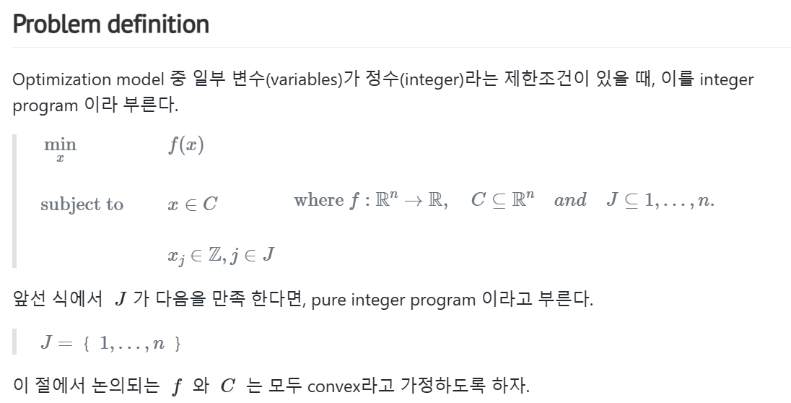
Integer Programing

Slide 4
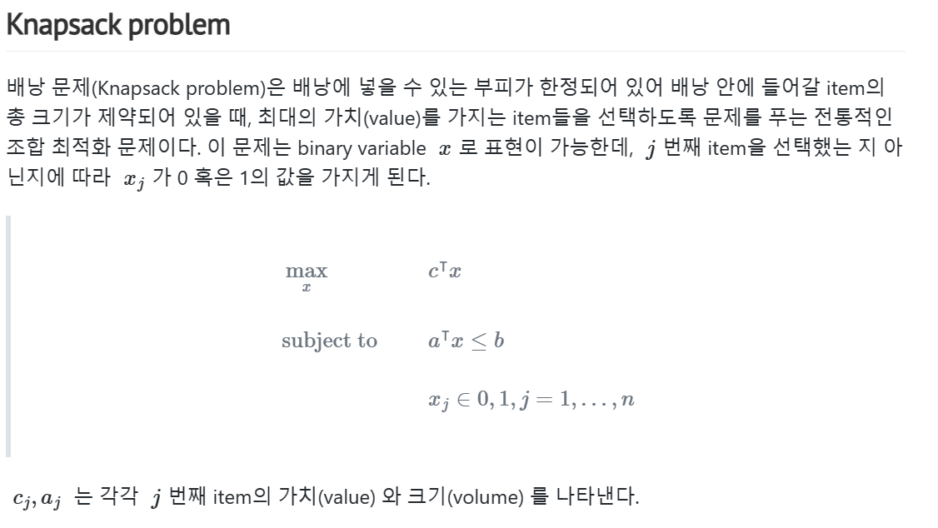
Examples of Integer Programming

Slide 5
Contributions
We demonstrate that, despite considering the full combinatorial nature of the network, our verifier can succeed at evaluating the robustness of larger neural networks, including those with convolutional and residual layers.
We identify why we can succeed on larger neural networks with hundreds of thousands of units. First, a large fraction of the ReLUs can be shown to be either always active or always inactive over the bounded input domain. Second, since the predicted label is determined by the unit in the final layer with the maximum activation, proving that a unit never has the maximum activation over all bounded perturbations eliminates it from consideration. We exploit both phenomena, reducing the overall number of non-linearities considered.
We determine for the first time the exact adversarial accuracy for MNIST classifiers to perturbations with bounded l1 norm. We are also able to certify more samples than the state-of-the-art and find more adversarial examples across MNIST and CIFAR-10 classifiers with different architectures trained with a variety of robust training procedures.

Slide 6
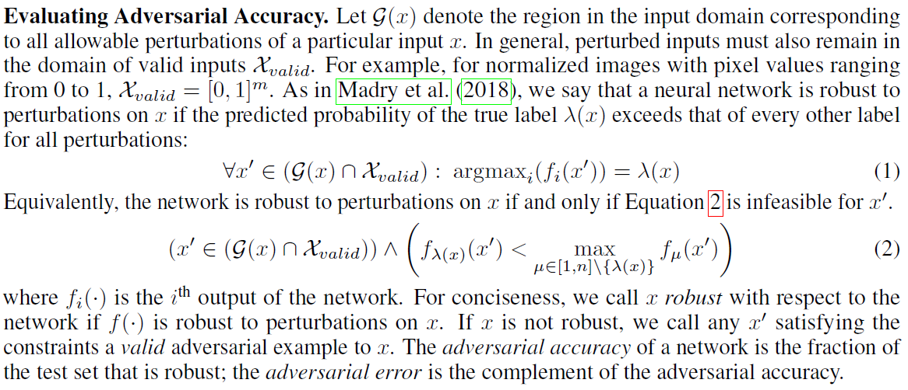
Definition of Robustness

Slide 7
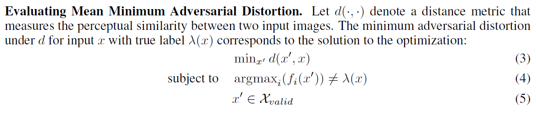
Minimum Adversarial Distortion

Slide 8
Formulating Piecewise-Linear Functions in the MILP Framework

Slide 9
Progressive Bounds Tightening
Tight bounds strengthen the problem formulation and thus improve solve times.
If we can prove that the phase of a ReLU is stable, we can avoid introducing a binary variable.

Slide 10
Progressive Bounds Tightening

Slide 11
Progressive Bounds Tightening

Slide 12
Experiment
MLP A: 1 hidden layer, 500 perceptrons per hidden layer.
MLP B: 2 hidden layer, 200 perceptrons per hidden layer.
CNN A: 2 convolutional layers, which have 16 and 32 filters, respectively.
CNN B: 4 convolutional layers, which have 32, 32, 64, 64 filters, respectively.
LP_d: the dual of a linear program
SDP_d: the dual of a semidefinite relaxation
ADV: Adversarial examples generated via Projected Gradient Descent (PGD)

Slide 13





Performance Comparisons: MILP

Slide 14
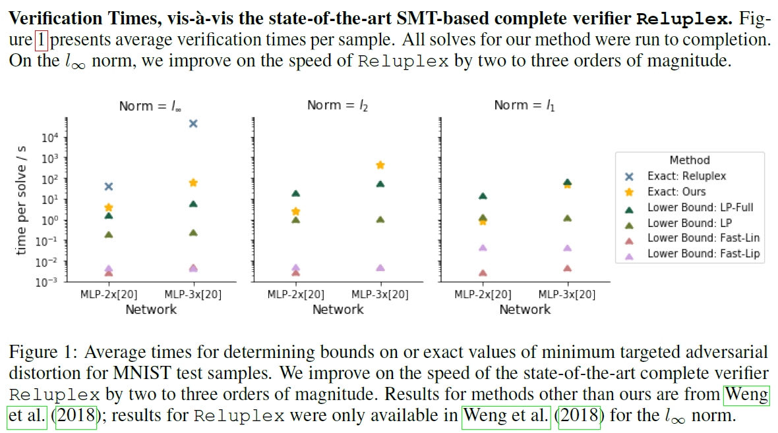
Performance Comparisons: Complete & Incomplete Verifiers

Slide 15
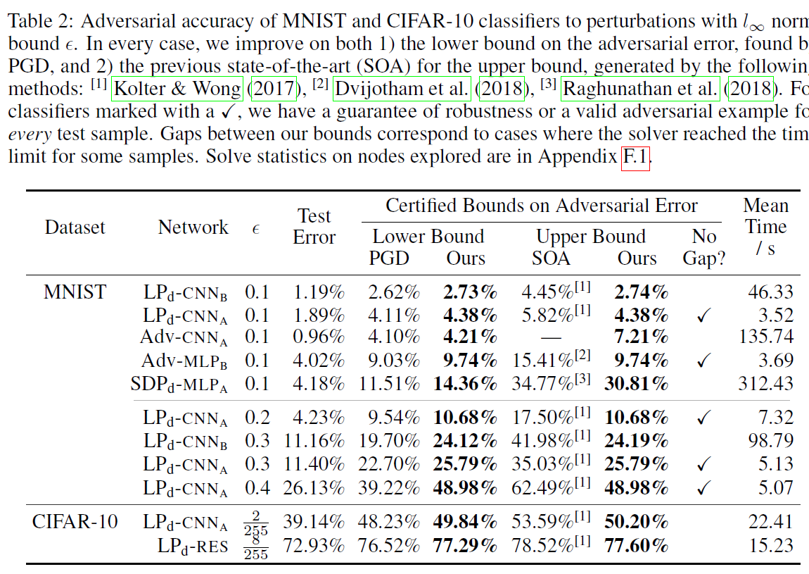
Determining Adversarial Accuracy

Slide 16
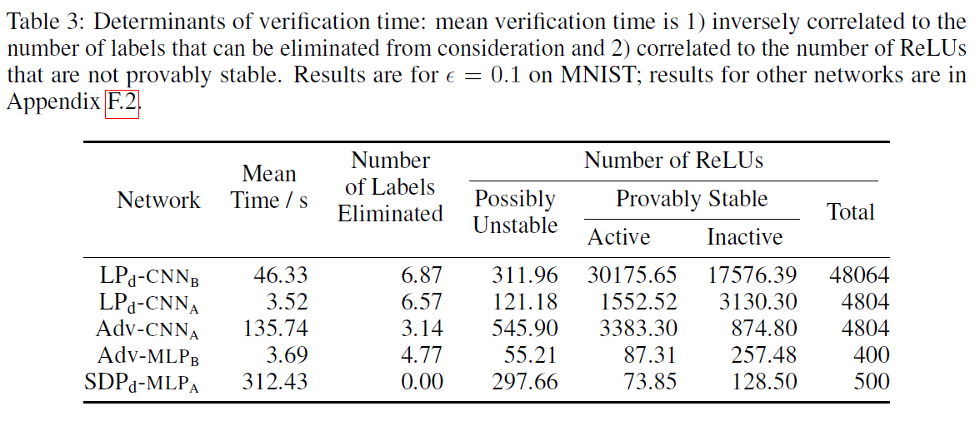
Determinants of Verification Time

